Slide 1
Node JS
Prepared by,
Dr. K. Vallidevi

Slide 2
Introduction
Node.js is a very powerful JavaScript-based platform built on Google Chrome's JavaScript V8 Engine.
It is used to develop I/O intensive web applications like video streaming sites, single-page applications, and other web applications.
Node.js is open source, completely free, and used by thousands of developers around the world.

Slide 3
Node.js = Runtime Environment + JavaScript Library
Asynchronous and Event Driven
Very Fast
Single Threaded but Highly Scalable
No Buffering
Where Not to Use Node.js?
It is not advisable to use Node.js for CPU intensive applications.

Slide 4
Components of Node JS Program
A Node.js application consists of the following three important components −
Import required modules − We use the require directive to load Node.js modules.
Create server − A server which will listen to client's requests similar to Apache HTTP Server.
Read request and return response − The server created in an earlier step will read the HTTP request made by the client which can be a browser or a console and return the response.

Slide 5
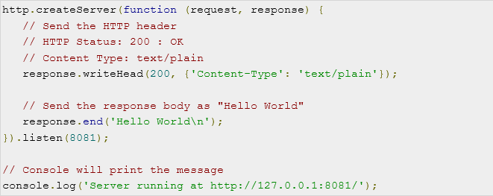
Creating Node.js Application
Step 1 - Import Required Module
var http = require("http");
Step 2 - Create Server

Slide 6
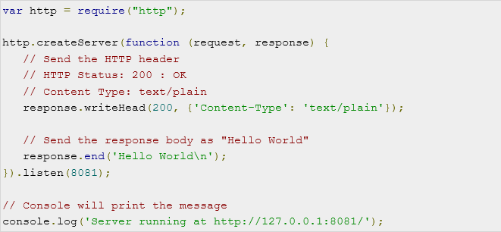
Creating Node.js Application
Step 3 - Testing Request & Response
Putting Step 1 and 2 together

Slide 7
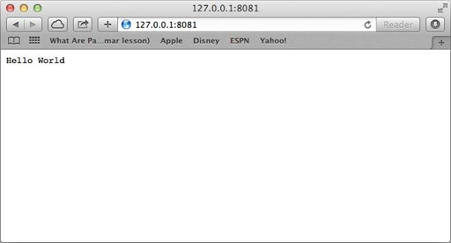
Running the application
C:\Users\vallidevik\Desktop\NodeJS>node CreatingServer.js
Server running at http://127.0.0.1:8081/
Make a Request to the Node.js Server
Open http://127.0.0.1:8081/ in any browser

Slide 8
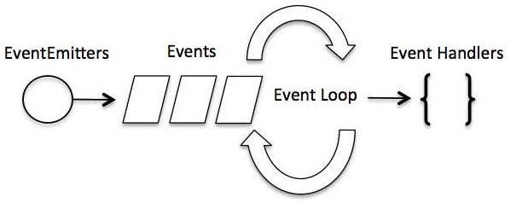
Event Driven Programming

Slide 9
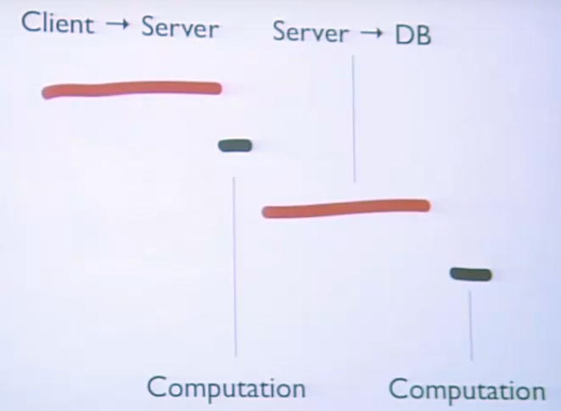
Why Node JS?

Slide 10
Example for Event Loop
const bar = () => console.log('bar')
const baz = () => console.log('baz')
const foo = () => {
console.log('foo')
bar()
baz()
}
foo()
The event loop on every iteration looks if there's something in the call stack, and executes it:

Slide 11
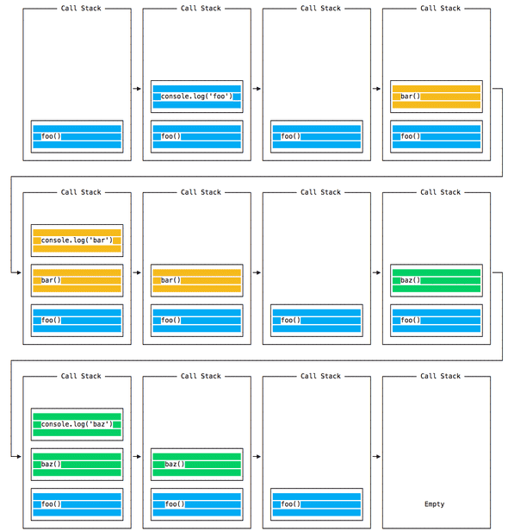

Slide 12
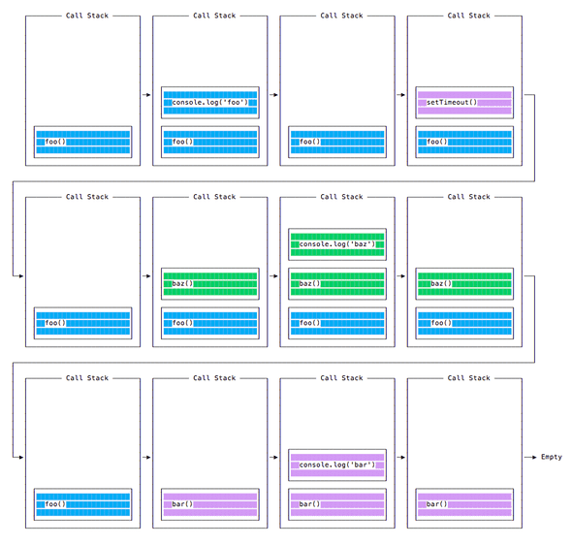
Queueing function execution

Slide 13
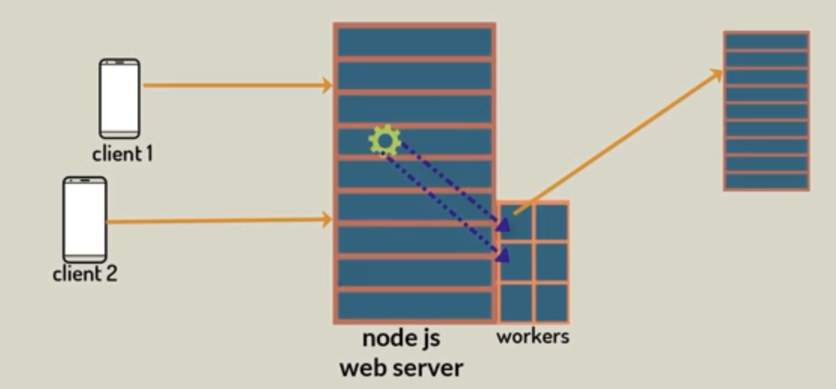
Non Blocking I/O

